Slide 1
What is Drafting?
Introduction and Careers
Notes:
Consider having a guest speaker from the industry or touring a related business.
This video covers an Intro to Drafting and a quick look at related careers

Slide 2
What is Drafting?
Creating graphical representations of a design (drawings)
Everything that needs to be built or assembled needs a drawing
Drawings communicate the size and location of various elements
Notes:
Talking points:
Consider a time when something was being assembled (for example: putting together a Lego set, assembling furniture, etc.)
The instructions indicated where each piece went
Everyone was on the same page
Now imagine a machine or a building being built and all the different pieces that need to go into specific place
Drafting creates the drawings for that machine or building to tell everyone what will go where

Slide 3
Different types of drafting
Drafters create drawings in a variety of industries
Examples:
Mechanical
Civil
Electrical
Industrial
Architectural
Interior Design
Notes:
Talking points:
Mechanical – designing parts to assemble, machinery, etc.
Civil – roads, bridges, site work
Electrical – coordinating the electrical elements
Industrial – laying out various elements in a factory (piping, etc)
Architectural – designing residential and commercial (schools, offices, etc.) buildings
Interior Design – focuses on the interiors of a building

Slide 4
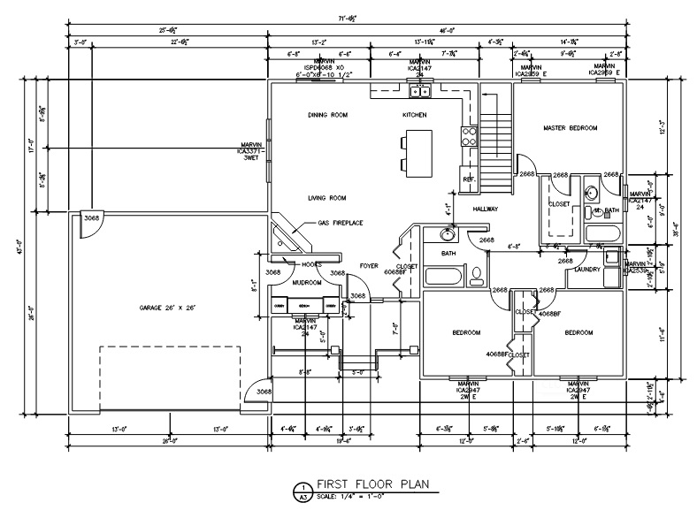
Examples of drafting
Drawing from Up & Running with AutoCAD, Gindis & Kaebisch
Floor plan courtesy of NCTC Arch Tech program
Mechanical
Architectural
Notes:
Talking points:
Mechanical piece is 4.5” x 3” overall, Architectural floor plan is 71’-6” x 43’-0”
Depending on the industry different content is drawn at different scales, or sizes
Entire cities and roadways can be drawn to scale to fit on a large sheet of paper

Slide 5
What’s the work like?
Largely working on a computer with various drawing programs like
AutoCAD
Solidworks
Inventor
Creo
Working in a office with an engineer or architect
Often team based projects
Notes:
Talking points:
As the purpose of the drawing is to communicate information to people, important skills to develop include communication skills, how you talk and write, and being able to work well with others as big projects typically involve a lot of people. Additionally important are the technical skills to operate the drawing program effectively.

Slide 6
Example of Drafting Career
Notes:
This links gives a good general overview of a drafting but in the context of precast concrete
https://www.youtube.com/watch?v=vRpwKMfAtXc&t=109s

Slide 7
Related Careers - Engineer
Designs products, devices, or systems using mathematical and scientific principles and techniques
Uses problem solving and analytical skills to work through designs
Helps manage projects to ensure budgets and timelines are maintained
Requires a 4 year Bachelor of Science from an ABET-accredited program

Slide 8
Related Careers – Types of Engineering
Civil Engineers: Design and oversee infrastructure projects like bridges, roads, and buildings.
Mechanical Engineers: Work with machinery and mechanical systems, from engines to HVAC systems.
Electrical Engineers: Focus on electrical systems, including power generation and electronic devices.

Slide 9
Related Careers - Architect
Designs a building or space based off client requirements and needs
For example: how many classrooms are needed, how many apartment units, how many bedrooms? Etc.
Applies rules and regulations to the design to ensure safety measures are met
Requires a 4 to 5 year Bachelor of Architecture program and passing a licensure exam

Slide 10
Related Careers – Interior Designer
Designs the interior of a space to meet client needs
Applies color, materials, and lighting while understanding various rules and regulations for specific areas
Handicapped accessible spaces for example
Requires a 2 or 4 year degree in Interior Design

Slide 11
Resources from
Architectural Drafting & Design, 7th Edition, Jefferis etc.

